Slide 1
Adapter Pattern

Slide 2
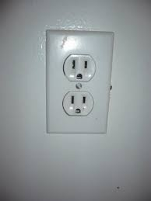



Recall…
Target
Adapter
Adaptee

Slide 3
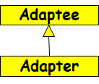

Class and Object Adapters
An adapter can be designed in two ways:
Inheritance
  Adapter sub-classes adaptee;
  It is the Class Adapter pattern
Delegation
  The adapter holds a reference to the adaptee object and delegates work to it;
  This is the Object Adapter pattern

Slide 4
Example 1 – Sets
There are many ways to implement a set
Assume:
  Your existing set implementation has poor performance.
You got hold of a more efficient set class,
  BUT: The new set has a different interface.
  Do not want to change voluminous client code
Solution: Design a class setAdapter:
  Same interface as the existing set..
  Simply translates to the new set’s interface.
Application
Set
NewSet
Adapter
Notes:
Of the many ways to implement a set, we have the one we’re using (OldSet) and the one we’ve acquired (NewSet). They have equivalent
functionality, but incompatible interfaces.

Slide 5
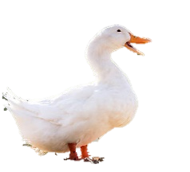
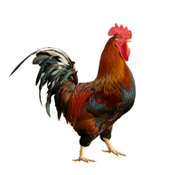
Class Adapter: Main Idea
Target
quack();
Adaptee
Cock-a-Doodle();
Client
Adapter
quack();

Slide 6
Object Adapter: Main Idea
Target
quack();
Adaptee
Cock-a-Doodle();
Client
Adapter
quack();

Slide 7
Example: Solution
Client
OldSet
Existing
add(Object e)
del(Object e)
int cardinality()
contains(Object e)
Got hold of Newset…
Target
NewSet
?
insert(Object e)
remove(Object e)
int size()
contains(Object e)
But, do not want to change Client code…
Adaptee
Notes:
This shows the current system, where clients use the interface given by OldSet, and we want to substitute in objects of type NewSet.

Slide 8
Object Adapter Pattern
  Object Adapter: main idea -- delegation
  The Adapter internally holds an instance of the Adaptee or a reference to it…
  Uses it to call Adaptee operations from within the operations required by the Target.
Target
Adaptee
add()
insert()
Adapter
Client
add()
insert();

Slide 9
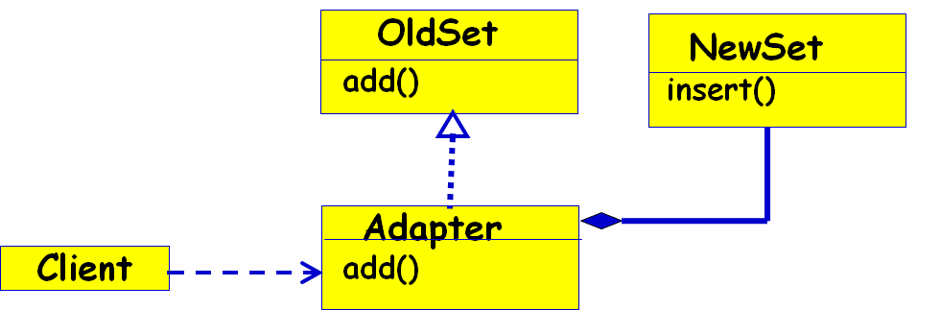
Object Adapter - Code
Client Code:
NewSet a =new NewSet(); OldSet t = new Adapter(a);
public void test() { t.add(); }
Target Code:
interface OldSet {
public void add(){}
}
Adaptee Code:
class NewSet {
public void insert(){}
}
Adapter Code:
class Adapter implements OldSet {
private NewSet nset;
public Adapter(NewSet a) { nset = a;}
public void add() { nset.insert();}
}

Slide 10
Class Adaptation
<<interface>>
OldSet
Adapter set makes NewSet appear as OldSet
OldSet is an interface, not a class
NewSet
add(Object e)
del(Object e)
int cardinality()
contains(Object e)
insert(Object e)
remove(Object e)
int size()
contains(Object e)
Adapter
add(Object e)
del(Object e)
int cardinality()
contains(Object e)
insert(e) ;
Client
Notes:
Class adaptation (not possible as such in Java, but common in C++). Use multiple inheritance to create an AdaptedSet. While it has the
interface OldSet expected in the system, it does simple forwarding to the relevant methods in NewSet.

Slide 11
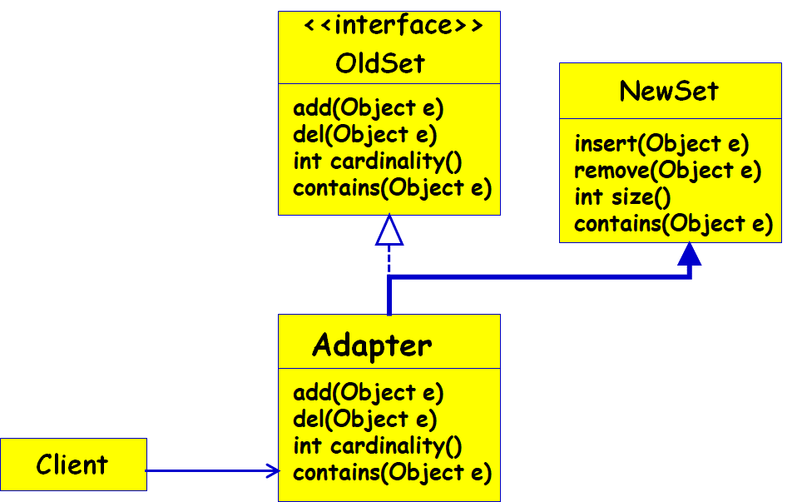
Class Adapter - Code
Client Code:
OldSet t = new Adapter();
public void test() { t.add(); }
Target Code:
interface OldSet {
public void add(){}
}
Adaptee Code:
class NewSet {
public void insert(){}
}
Adapter Code:
class Adapter extends NewSet implements OldSet {
public void add() { insert();}
}

Slide 12
Example: Restaurant Application
A restaurant application uses geo-coded address for customer delivery (Longitude, Latitude).
However, the customer application uses traditional address (House #, Street # etc).
Both are working software:
  You do not want to change either.

Slide 13
Object Adapter Pattern
Example 2: Restaurant Adaptation
Solution: Object Adapter
Target
Customer
getAddressGL()
getAddress()
RestrantAdapter
Restaurant
Application
getAddressGL()
getAddress ;

Slide 14
Example Code: Object Adapter
class Customer{
Address getAddress(String address, String city, String state, String zip){
// do some calculation
}
} –Adaptee
interface Target{
void getAdressGL(String lat, String lng);
} - Restaurant application uses geocoded addresses.
class CustomerAdapter implements Target{
private Customer customer = new Customer();
public void getAddressGL(String lat, String lng){
// calculate latitude and longitude
// return address, city, state, zip
Adress=customer.getAddress();
GLAddress=conv(Address);
}
}

Slide 15
Adapter design pattern for comparing Objects
Client
Comparator
Student
int compare()
int score()
adaptee
StudComparator
int compare()
This idea has been used in implementing
“Comparable” in Java

Slide 16
Java Comparator: Example
class Student{
int rollno;
String name, address;
}
ArrayList <Student> al=new ArrayList<Student>();
Collections.sort(al,new SortByName());
Collections.sort(al,new SortByRoll());

Slide 17
Example: StudentComparator
public class SortByRoll
implements Comparator<Student> {
public int compare(Student s1,
Student s2){
    return s1.score() – s2.score();}
    }

Slide 18
Example: StudentComparator
public class SortByName
implements Comparator<Student> {
public int compare(Student s1,
Student s2){
    return s1.name.CompareTo(s2.name);}
  }

Slide 19
Variant: Universal Adapter--Adapt Multiple Versions of NewSet
(Object only) Several subclasses to adapt:
  Too expensive to adapt each subclass.
  Create single adapter to superclass interface.
  Configure the AdaptedSet with the specific NewSet at run-time.
Client
OldSet
AdaptedSet
adaptee
NewSet
NewHashSet
NewBitSet
Notes:
Using an object adapter we can adapt any set that corresponds to the NewSet interface – including any subclasses that have variant implementation.

Slide 20
public class IPhoneCharger1 { public void iPhoneCharge(){
System.out.println("The iPhone is charging ..."); } }
public interface ChargAdapter{ public void phoneCharge(); }
public class UniversalCharger extends IPhoneCharger1 implements ChargAdapter{
public void phoneCharge() {
super.iPhoneCharge(); } }
✗
Class adapter:
    Adapter object can have at most two faces.
public class UniversalCharger implements ChargeAdapter{
IPhoneCharger iphoneCharger;
public UniversalCharger(IPhoneCharger iphoneCharger1){
this.iphoneCharger = iphoneCharger; }
public void phoneCharge() {
iphoneCharger.iPhoneCharge(); }
Adapter
iPhoneCharger
iPhoneCharge1
iPhoneCharge2
Object adapter

Slide 21

Consequences - Class Adapters
Creates concrete adapter for a specific Adaptee (e.g., NewSet):
  Not really a wrapper pattern…
- Cannot adapt a class and all its subclasses…
+ Can override Adaptee (e.g., NewSet) behavior:
  After all, Adapter is a subclass of Adaptee
Obj

Slide 22
Consequences - Object Adapters
Single Adapter can handle many Adaptees (Universal adaptor):
  Can adapt the Adaptee class and all its subclasses.
The biggest benefit of Object Adapter compared to Class Adapter ( and thus Inheritance ):
  Loose coupling of client and adaptee.
Hard to override Adaptee behavior
  Because the Adapter uses but does not inherit from Adaptee interface.

Slide 23
Other Issues
How much adapting does adapter do?
  Simple forwarding of requests (renaming)?
  Different set of operations and semantics?
  At some point do the Adaptee and Adapter interfaces and functionality diverge so much that “adaption” is no longer the correct term…

Slide 24
Advantages of Adapter Pattern
Can help change behavior of existing software:
  Without changing its source code.
Can help use legacy software:
  Without making any modifications to old source code

